Slide 1

User Churn - Codeflix
Analyze Data with SQL
Athena Mascarenhas
September 14th, 2024

Slide 2
Table of Contents
Project Description
Company Information
Churn Rates of Segments
4. Conclusion
5. Appendix

Slide 3
1. Project Description

Slide 4
1. Project Description
Four months into launching Codeflix, management asks you to look into subscription churn rates. It’s early on in the business and people are excited to know how the company is doing
The marketing department is particularly interested in how the churn compares between two segments of users. They provide you with a dataset containing subscription data for users who were acquired through two distinct channels.
The dataset provided to you contains one SQL table, subscriptions. Within the table, there are 4 columns:
id - the subscription id
subscription_start - the start date of the subscription
subscription_end - the end date of the subscription
segment - this identifies which segment the subscription owner belongs to

Slide 5
2. Company Information

Slide 6
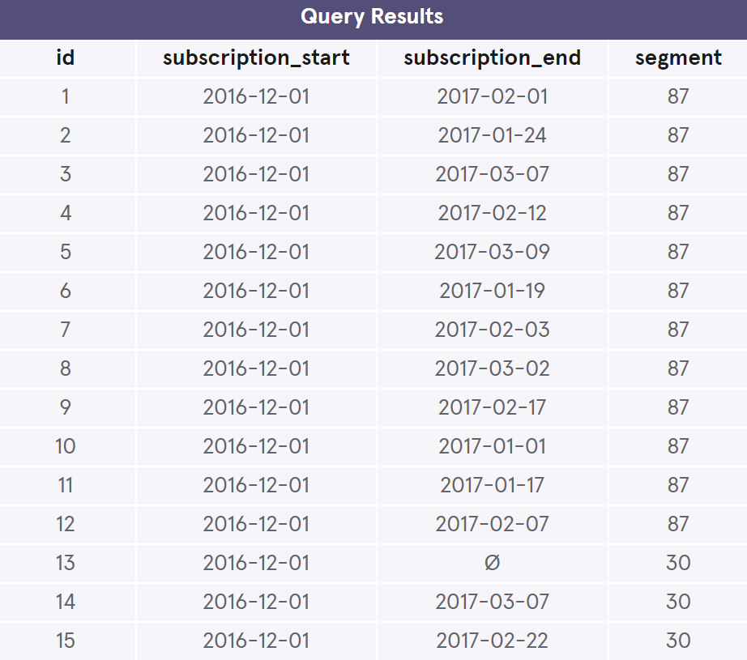
2.1 Company Information
Codeflix, a streaming video startup, is interested in measuring their user churn rate. Codeflix requires a minimum subscription length of 31 days, so a user can never start and end their subscription in the same month.
Here is a snippet of the subscriptions table:

Slide 7
2.2 Company Information: Date Range and Segments
The company has been operating for about four months from December 2016 through March 2017.
Since Codeflix requires a minimum subscription length of 31 days, there is no subscription_end dates in December!
There are two user segments: 87 and 30
SELECT MIN(subscription_start) as date_min, MAX(subscription_start) as date_max
FROM subscriptions;
date_min | date_max
2016-12-01 | 2017-03-30
SELECT DISTINCT segment FROM subscriptions;
segment
87
30

Slide 8
3. Churn Rates of Segments

Slide 9
3. Churn Rates of Segments
We will determine the churn rates of segment 87 and segment 30. Here is an overview of the process:
3.1 Create temporary months table
3.2 (Cross) Join subscriptions table with months
3.3 Create temporary status table with active and cancelled subscription flags
3.4 Create temporary table with aggregated active and cancelled subscription flags
3.5 Calculate the churn rates using temporary tables
3.

Slide 10
2. What is the overall churn trend since the company started?
3. Compare the churn rates between user segments.
Which segment of users should the company focus on expanding?

Slide 11
3.1 Churn Rates of Segments: Create temporary months table
Since there is no months table available, a temporary months table was created with the first_day and last_day of each of the three months (January through March).
--create temporary months table
WITH months as (
SELECT '2017-01-01' as first_day,
'2017-01-31' as last_day
UNION
SELECT '2017-02-01' as first_day,
'2017-02-28' as last_day
UNION
SELECT '2017-03-01' as first_day,
'2017-03-31' as last_day
)
SELECT * FROM months;
first_day | last_day
2017-01-01 | 2017-01-31
2017-02-01 | 2017-02-28
2017-03-01 | 2017-03-31

Slide 12
3.2 Churn Rates of Segments: (Cross) Join subscriptions table with months
Next, the main subscriptions table was cross joined with months to create a new temporary table called, cross_join.
id | subscription_start | subscription_end | segment | first_day | last_day
1 | 2016-12-01 | 2017-02-01 | 87 | 2017-01-01 | 2017-01-31
1 | 2016-12-01 | 2017-02-01 | 87 | 2017-02-01 | 2017-02-28
1 | 2016-12-01 | 2017-02-01 | 87 | 2017-03-01 | 2017-03-31
2 | 2016-12-01 | 2017-01-24 | 87 | 2017-01-01 | 2017-01-31
2 | 2016-12-01 | 2017-01-24 | 87 | 2017-02-01 | 2017-02-28
2 | 2016-12-01 | 2017-01-24 | 87 | 2017-03-01 | 2017-03-31
3 | 2016-12-01 | 2017-03-07 | 87 | 2017-01-01 | 2017-01-31
3 | 2016-12-01 | 2017-03-07 | 87 | 2017-02-01 | 2017-02-28
--create temporary cross_join table
--Limited to 8 records
cross_join as (
SELECT * from subscriptions
CROSS JOIN months
)
SELECT * FROM cross_join
LIMIT 8;
Note: The code above is a continuation of the WITH clause from 3.1. Due to limited space, we are not including the entire code.

Slide 13
3.3 Churn Rates of Segments: Create temporary status table with active and cancelled subscription flags
status as (
SELECT id, first_day as month,
CASE WHEN (
segment == 87 AND
subscription_start < first_day AND
(subscription_end > first_day OR
subscription_end IS NULL)
) THEN 1
ELSE 0 END AS is_active_87,
CASE WHEN (
segment == 30 AND
subscription_start < first_day AND
(subscription_end > first_day OR
subscription_end IS NULL)
) THEN 1
ELSE 0 END AS is_active_30,
CASE WHEN (
segment == 87 AND
subscription_end BETWEEN first_day and last_day
) THEN 1
ELSE 0 END AS is_canceled_87,
CASE WHEN (
segment == 30 AND
subscription_end BETWEEN first_day and last_day
) THEN 1
ELSE 0 END AS is_canceled_30
FROM cross_join)
SELECT * FROM status LIMIT 8;
Created a temporary status table that will contain the subscription id, month (first day) and the active and cancelled subscription flags for each segment.
The active and canceled flags will be 1 (yes) or 0 (no).
Results of the code will be in the next slide
Note: The code above is a continuation of the WITH clause from 3.1 and 3.2. Due to limited space, we are not including the entire code.

Slide 14
3.3 Churn Rates of Segments: Create temporary status table with active and cancelled subscription flags
id | month | is_active_87 | is_active_30 | is_canceled_87 | is_canceled_30
1 | 2017-01-01 | 1 | 0 | 0 | 0
1 | 2017-02-01 | 0 | 0 | 1 | 0
1 | 2017-03-01 | 0 | 0 | 0 | 0
2 | 2017-01-01 | 1 | 0 | 1 | 0
2 | 2017-02-01 | 0 | 0 | 0 | 0
2 | 2017-03-01 | 0 | 0 | 0 | 0
3 | 2017-01-01 | 1 | 0 | 0 | 0
3 | 2017-02-01 | 1 | 0 | 0 | 0

Slide 15
3.4 Churn Rates of Segments: Create temporary table with aggregated active and cancelled subscription flags
Created a temporary table that stored the month (first day) and the counts of the active and cancelled flags for each segment.
--create a temporary table with aggregated flags
status_aggregate AS (
SELECT month,
SUM(is_active_87) as active_87,
SUM(is_active_30) as active_30,
SUM(is_canceled_87) as canceled_87,
SUM(is_canceled_30) as canceled_30
FROM status
GROUP BY 1
)
SELECT * FROM status_aggregate;
month | active_87 | active_30 | canceled_87 | canceled_30
2017-01-01 | 278 | 291 | 70 | 22
2017-02-01 | 462 | 518 | 148 | 38
2017-03-01 | 531 | 716 | 258 | 84
Note: The code above is a continuation of the WITH clause from 3.1-3.3. Due to limited space, we are not including the entire code.

Slide 16
3.5 Churn Rates of Segments: Calculate the churn rates using temporary tables
Finally, calculated the churn rates of each segment for each of the months (January through March).
Segment 30 has a lower churn rate than segment 87.
--Calculate churn rates
SELECT month,
1.0 * canceled_87/active_87 as churn_rate_87,
1.0 * canceled_30/active_30 as churn_rate_30
FROM status_aggregate;
month | churn_rate_87 | churn_rate_30
2017-01-01 | 0.251798561151079 | 0.0756013745704467
2017-02-01 | 0.32034632034632 | 0.0733590733590734
2017-03-01 | 0.485875706214689 | 0.11731843575419
Note: The code above is a continuation of the WITH clause from 3.1 - 3.4. Due to limited space, we are not including the entire code.

Slide 17
4. Conclusion

Slide 18
5. Conclusion
It looks like the churn rate for both segments increase as the months progress
Segment 87 has a higher churn rate compared to Segment 30. The company should look into what’s working for segment 30 and what’s not for 87.
The company should probably consider looking at the new subscriber rate to make sure that the new subscriber rate is higher than the churn rate.

Slide 19
5. Appendix

Slide 20
4.1 Alternate Code (without hardcoding segments)
WITH months as (
SELECT '2017-01-01' as first_day,
'2017-01-31' as last_day
UNION
SELECT '2017-02-01' as first_day,
'2017-02-28' as last_day
UNION
SELECT '2017-03-01' as first_day,
'2017-03-31' as last_day
),
cross_join as (
SELECT * from subscriptions
CROSS JOIN months
),
status as (
SELECT id, first_day as month, segment,
CASE WHEN (
subscription_start < first_day AND
(subscription_end > first_day OR
subscription_end IS NULL)
) THEN 1
ELSE 0 END AS is_active,
CASE WHEN (
subscription_end BETWEEN first_day and last_day
) THEN 1
ELSE 0 END AS is_canceled
FROM cross_join
), status_aggregate AS (
SELECT month, segment,
SUM(is_active) as active,
SUM(is_canceled) as canceled
FROM status
GROUP BY 1,2
)
SELECT month, segment,
1.0 * canceled/active as churn_rate
FROM status_aggregate;
The project tasked us to generate the churn rate for each segment without hardcoding the segments.
This results in a smaller block of code and can accommodate any number of segments.
Results on the next slide. Results should be the same.

Slide 21
4.2 Alternate Code (without hardcoding segments): Results
Results of the Original Code:
month | churn_rate_87 | churn_rate_30
2017-01-01 | 0.251798561151079 | 0.0756013745704467
2017-02-01 | 0.32034632034632 | 0.0733590733590734
2017-03-01 | 0.485875706214689 | 0.11731843575419
Results of the Alternate Code:
month | segment | churn_rate
2017-01-01 | 30 | 0.0756013745704467
2017-01-01 | 87 | 0.251798561151079
2017-02-01 | 30 | 0.0733590733590734
2017-02-01 | 87 | 0.32034632034632
2017-03-01 | 30 | 0.11731843575419
2017-03-01 | 87 | 0.485875706214689

